Slide 1

Linear Integrated Circuits EE-411 L1
Dr. Syed Arsalan Jawed
Associate Professor of Practice
Office Hours : W-301, Tuesday/Thursday : 1600-1700
September 02-04, 2025
H-505
!پھربرق فروزاں ہےسر وادی سینا ، اۓدیدہ بینا
The flame of illumination set ablaze…. O’ the beholder of sight!

Slide 2
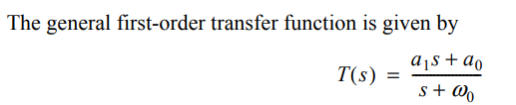

First Order and Second Order Filters

Slide 3
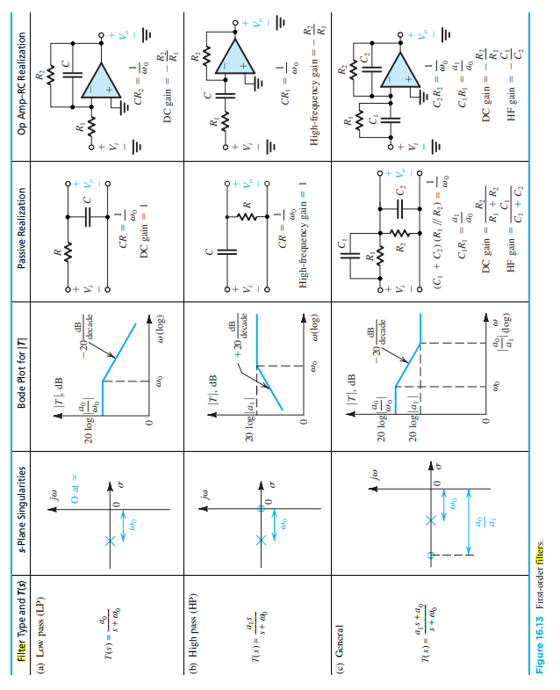

Slide 4
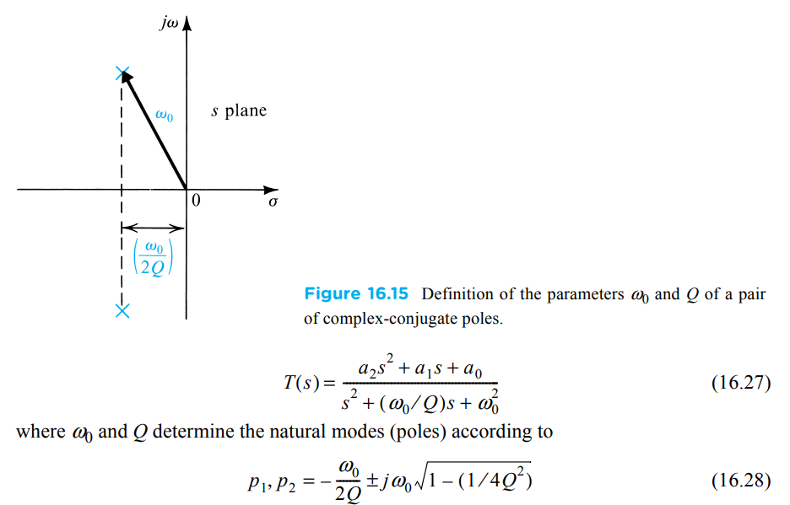


Second Order Filters

Slide 5
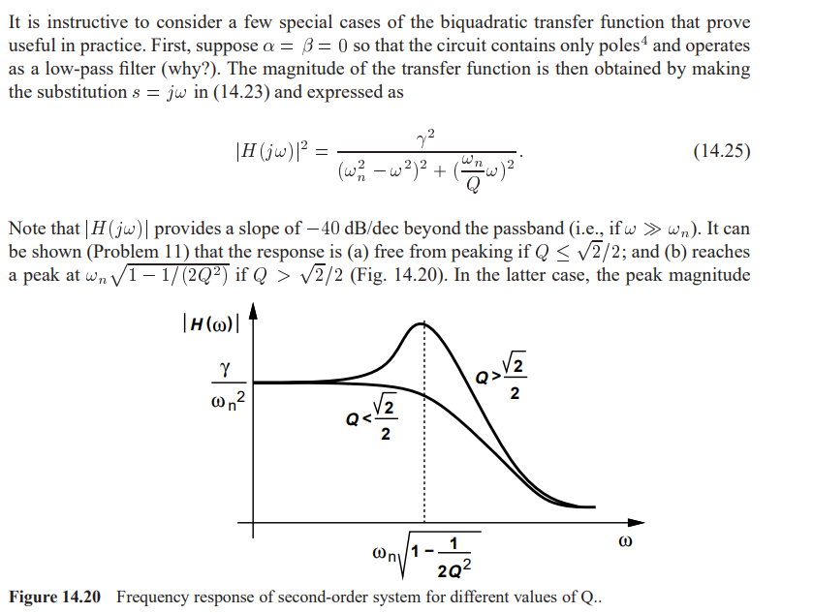
Special Cases

Slide 6
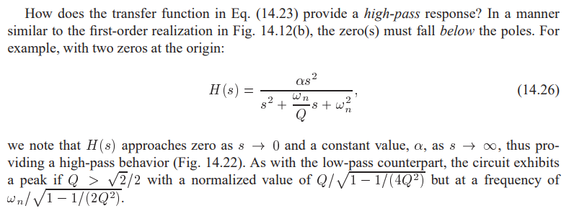

Slide 7
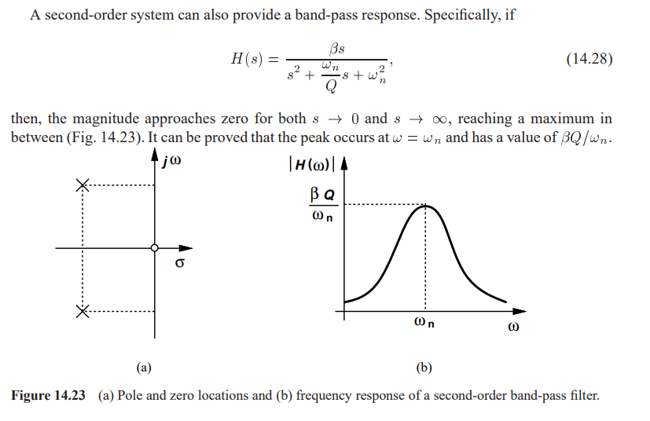

Slide 8
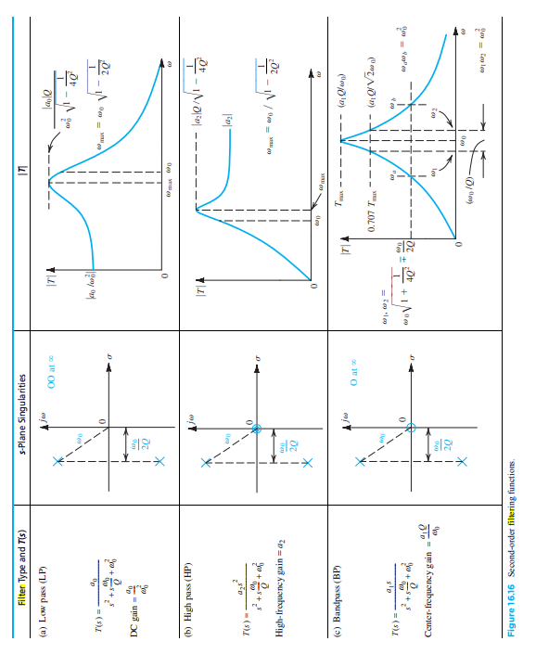

Slide 9
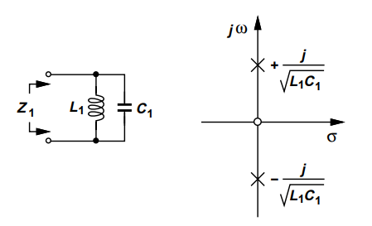
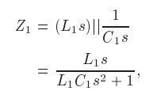
RLC Realization / RLC Resonator

Slide 10
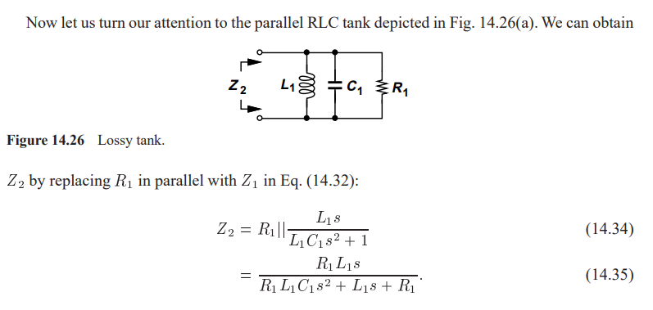
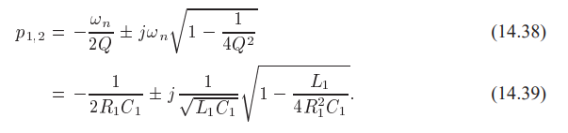

Slide 11
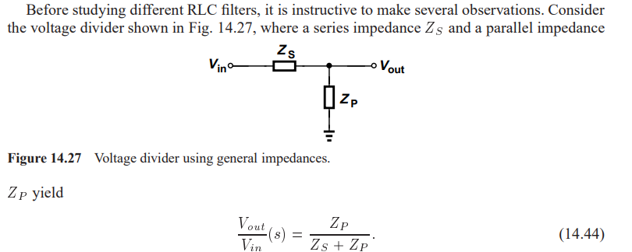
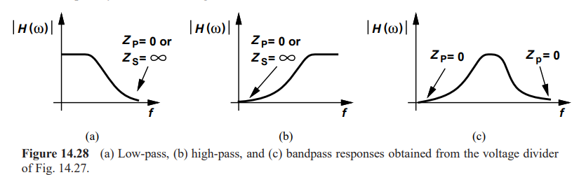

Slide 12
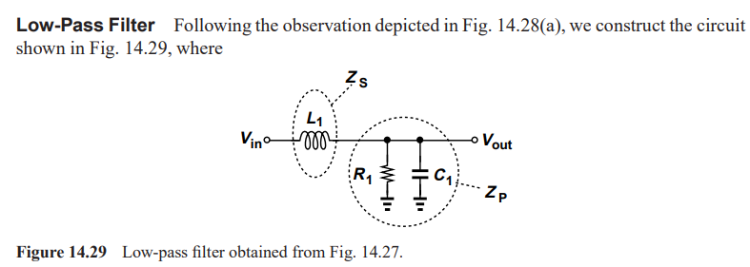
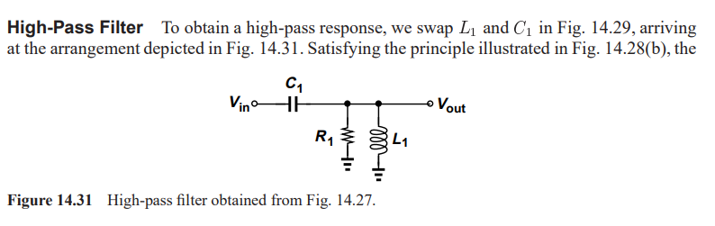

Slide 13
